Slide 1

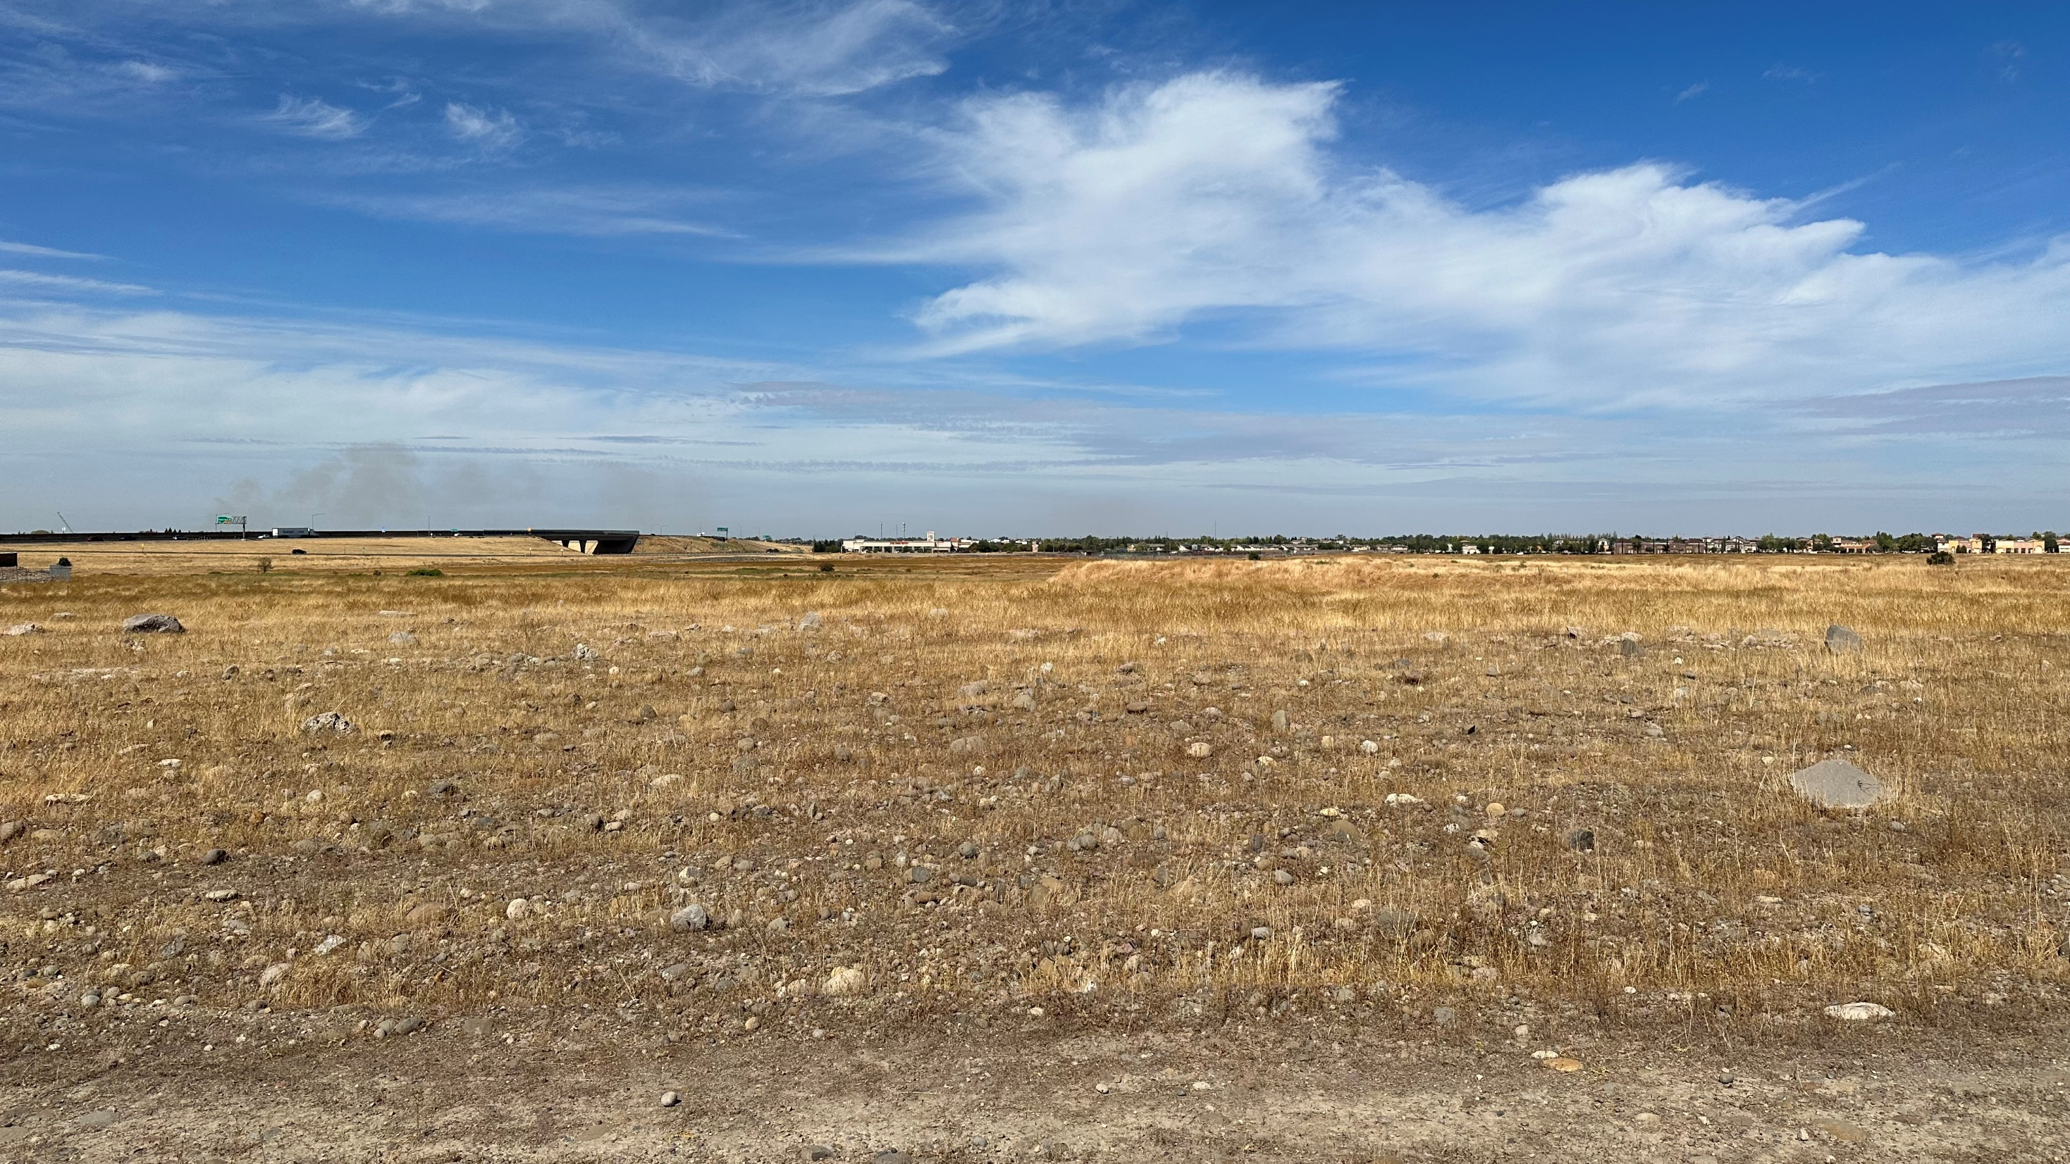

Bella Breeze
Community Park
Community Workshop #1
10.17.2023

Slide 2
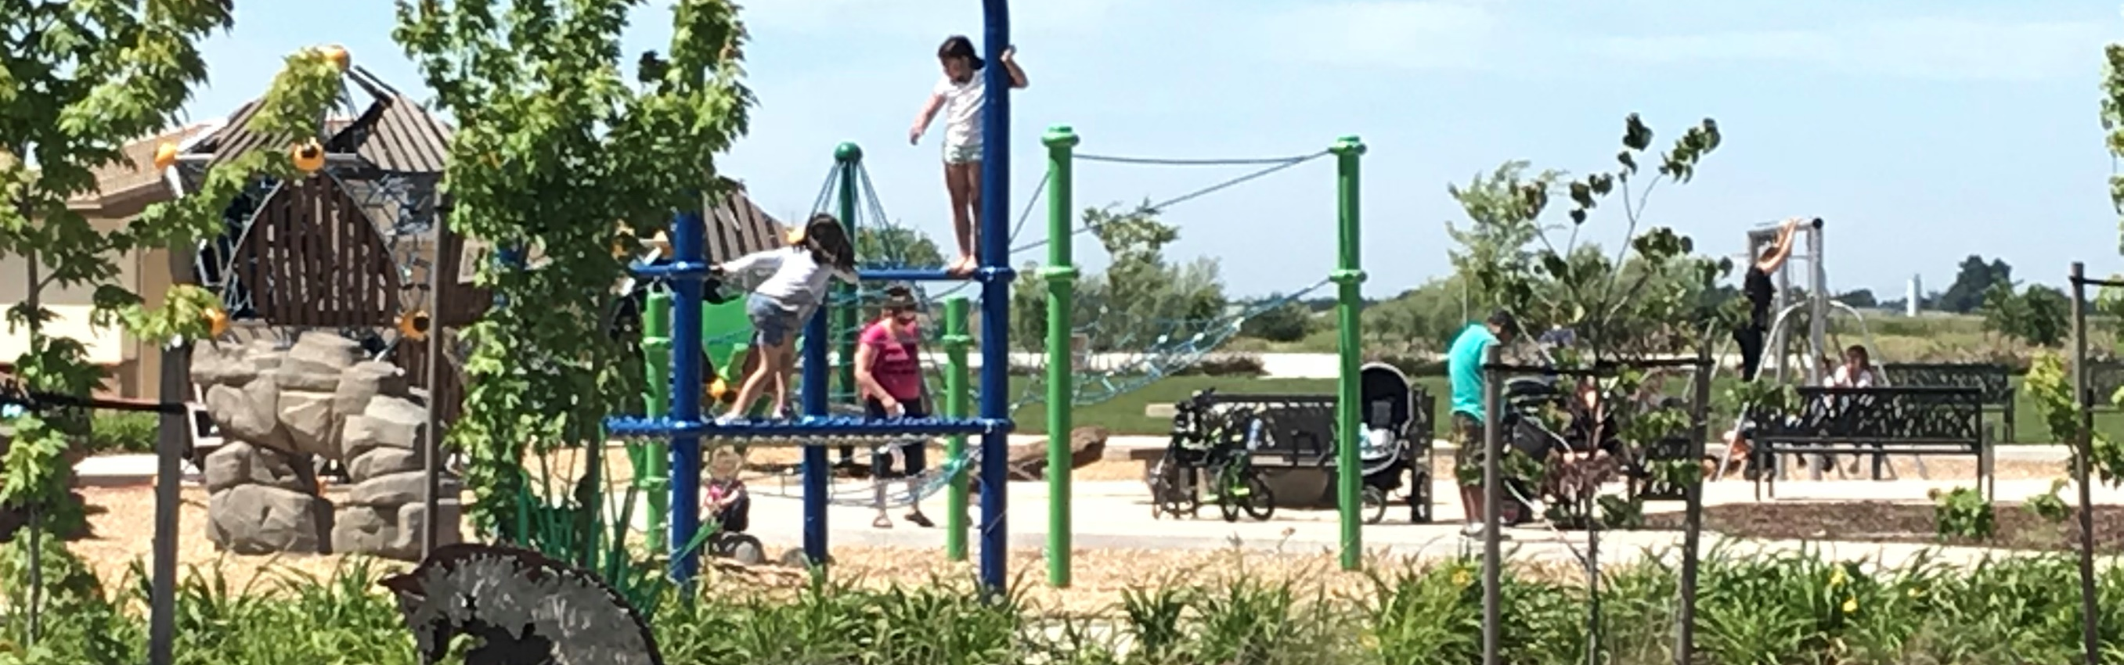
Welcome and Introductions
Araceli Cazarez, City of Lincoln Project Manager (araceli.cazarez@lincolnca.gov)
Dalton LaVoie, Landscape Architect, Stantec Project Manager

Slide 3
TIME | AGENDA ITEM | PRESENTER
6:00 | Welcome and Introductions | Araceli Cazarez/City
6:05 | Project Background and Schedule | Araceli Cazarez/City
6:20 | Workshop Housekeeping | Dalton LaVoie/Stantec
6:25 | Community Feedback (60 Minutes) | Dalton LaVoie/Stantec
 | Park Site Opportunities and Constraints | Dalton LaVoie/Stantec
 | Park Program Amenities and Priorities | Dalton LaVoie/Stantec
 | Park Design Ideas (Theme, Safety, Beautification) | Dalton LaVoie/Stantec
7:25 | Summary & Next Steps | Araceli Cazarez/City
7:30 | Adjourn | Araceli Cazarez/City

Slide 4
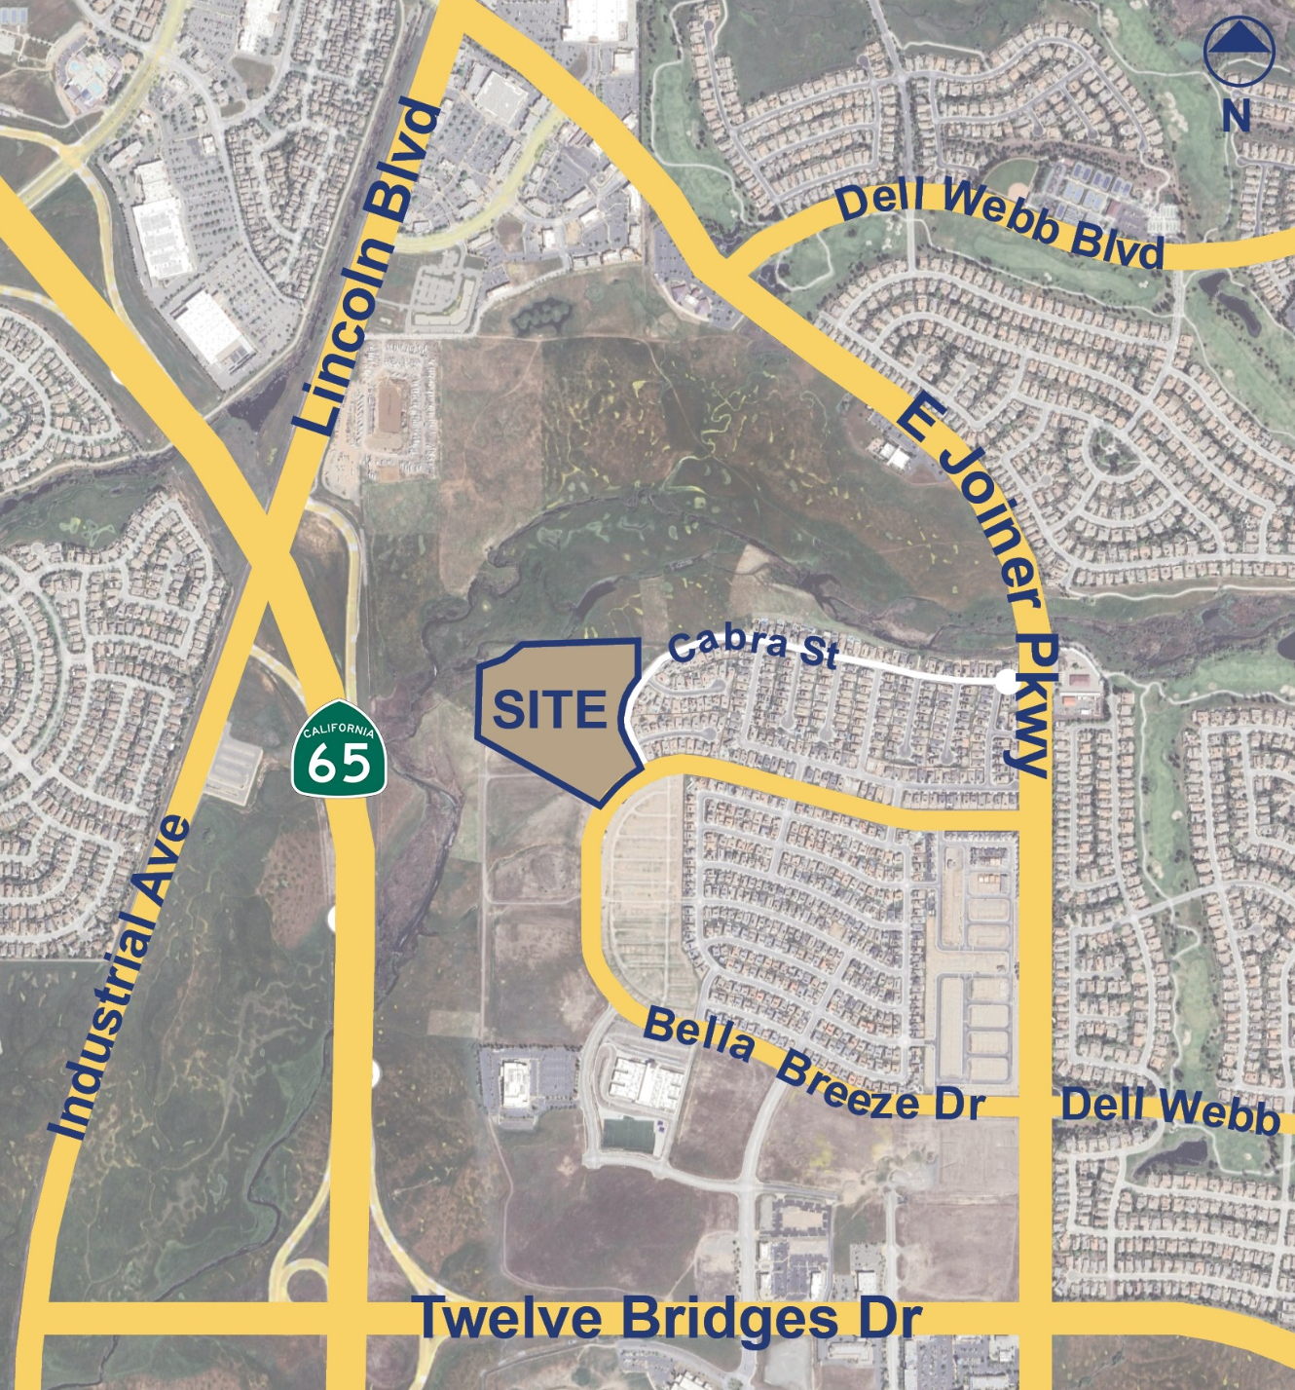
Project Background
City of Lincoln has budgeted funds to master plan a new 18.5-acre park within the Twelve Bridges community.
The master plan will provide recommendations for the park including appropriate uses, amenities, and an implementation strategy. Recommendations may include but are not limited to:
  Active and passive recreational amenities
  Themed play structures
  Picnic areas
  Hardcourts & turf playfields
  Parking lots
  Restrooms
City staff are working with design and engineering team at Stantec to master plan the site.
Community input is an important step in the process.

Slide 5
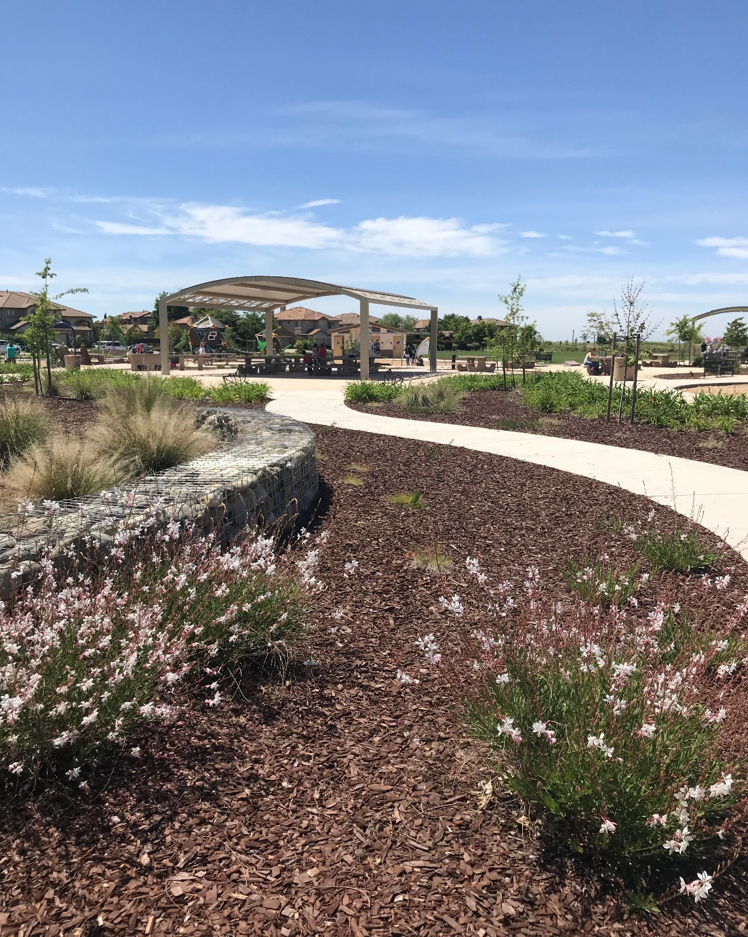
Project Schedule
October 9th – October 23rd, 2023
  Community Outreach Survey #1 – Amenity Preferences and Design Ideas. OPEN NOW!
October 17th, 2023
  Community Outreach Meeting #1 – Amenity Preferences and Design Ideas. Held virtually via ZOOM. WE ARE HERE.
December 6th, 2023
  Parks and Recreation Committee Meeting #1 – Three Preliminary Design Concepts.
December 11th, 2023
  Community Outreach Meeting #2 – Three Preliminary Design Concepts reviewed. In-person Twelve Bridges Library Willow Room.
December 11th – January 9th, 2023
  Community Survey #2 - Three Preliminary Design Concepts and Phase 1 Construction Priorities.
  March, 2024
  Preferred Master Plan for approval at Park and Recreation Committee and City Council including Phase 1 boundary.
2025 Construction currently anticipated to begin

Slide 6

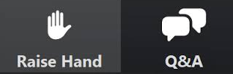
Workshop Housekeeping
During presentation:
  Attendees Muted
  Cameras Off
If you have a Question or a Comment:
  Option 1: Raise Your Hand, we will unmute
  Option 2: Type it into the Q&A Box, your question will be sent to the panel
  1 speaker at a time
3 minutes per speaker

Slide 7
Community
Feedback
Community Workshop #1
10.17.2023

Slide 8

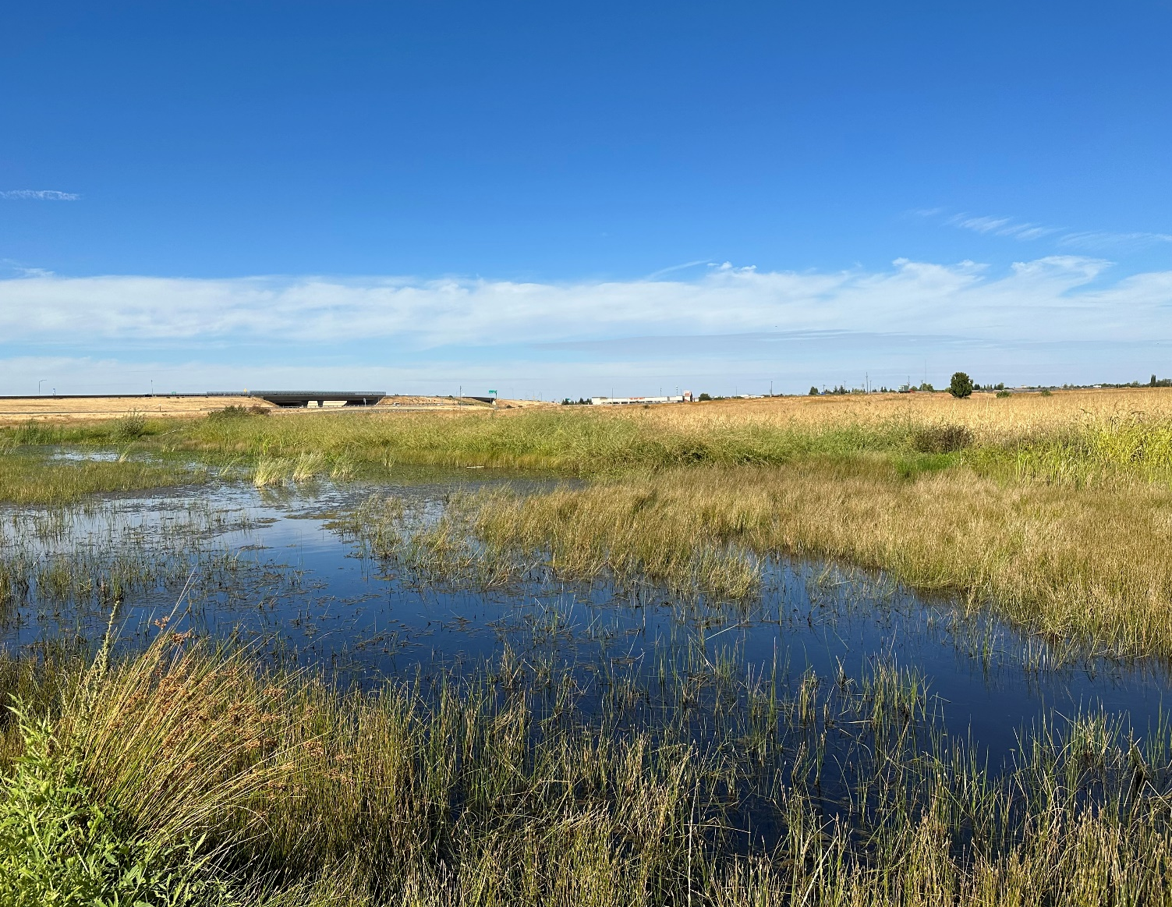

Community Outreach Overview & Purpose
YOUR IDEAS
  Amenities/Facilities
  Priorities/Preferences
  Design/Theme
  Safety
  Beautification
Let’s start with THE SITE…

Slide 9
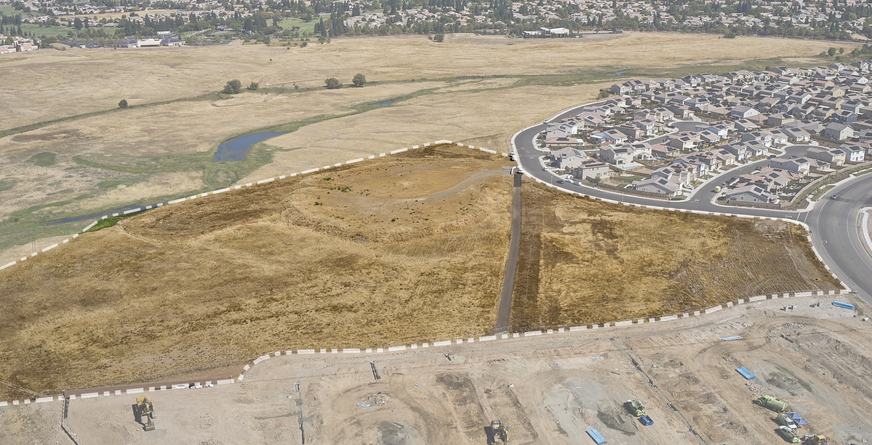
E Joiner Parkway
Open Space Preserve
Cabra St
Bella Breeze
Drive
BELLA BREEZE
COMMUNITY PARK SITE
McCullough St (under construction)
N

Slide 10
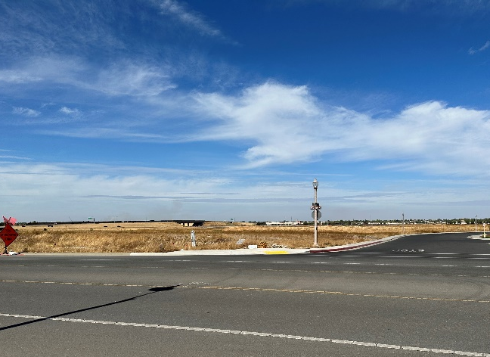
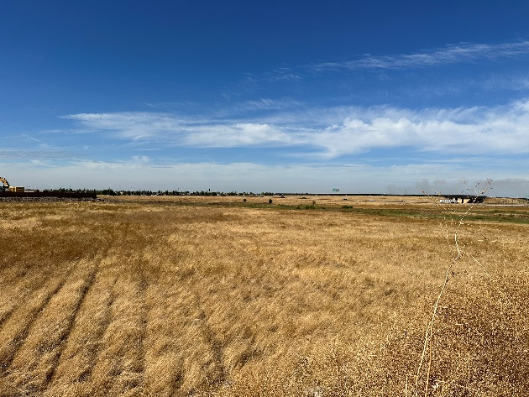
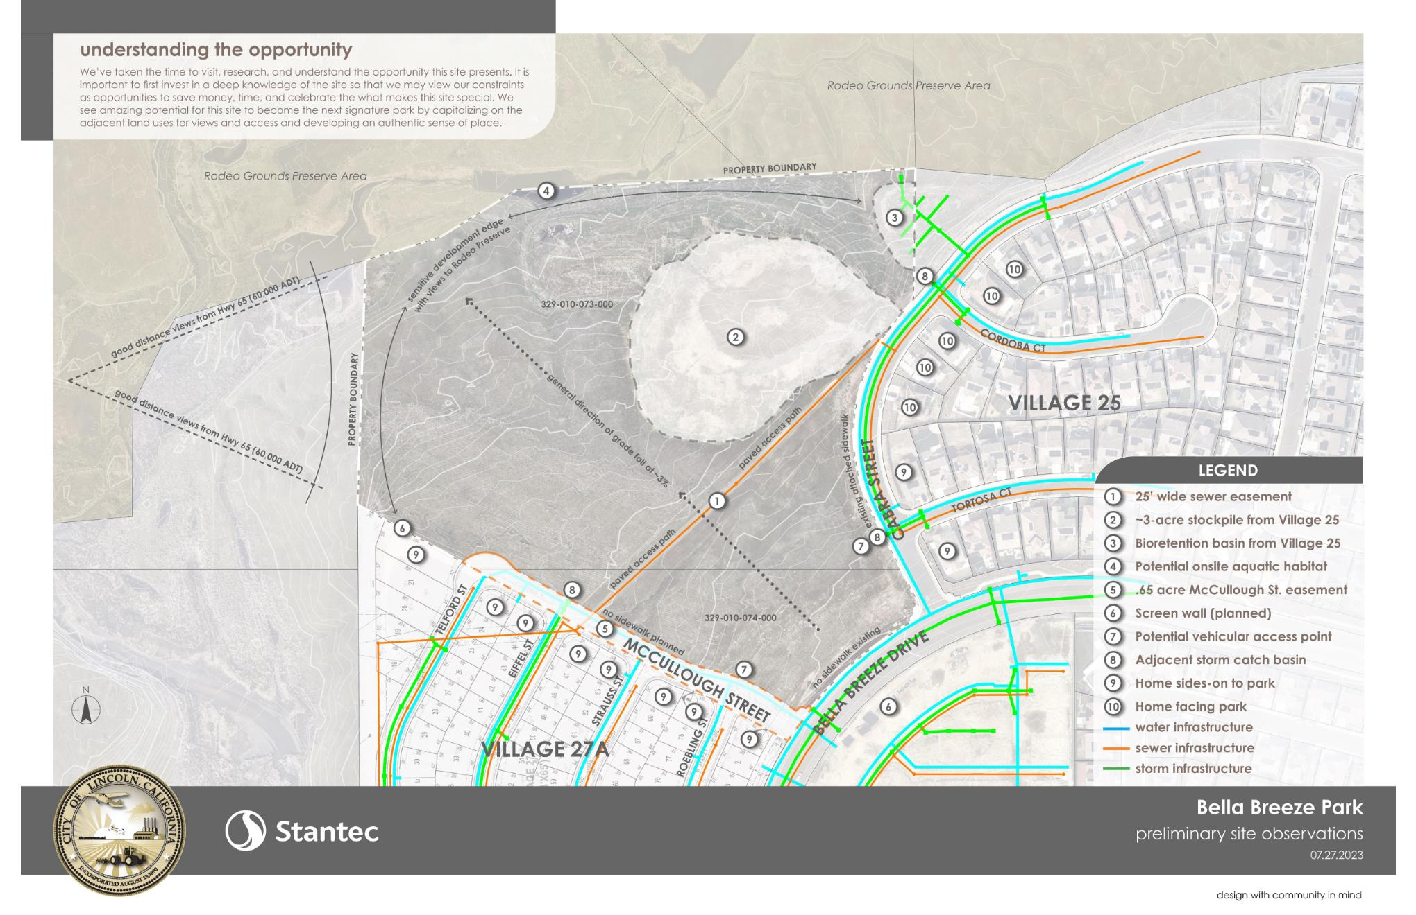
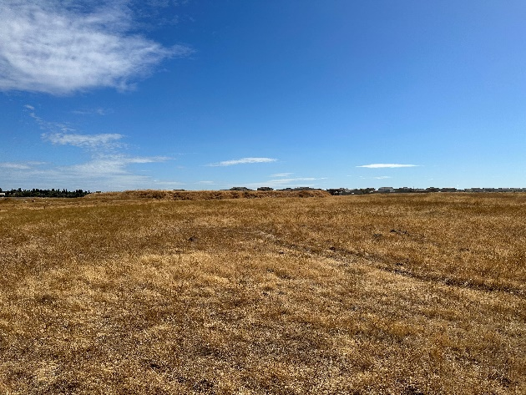
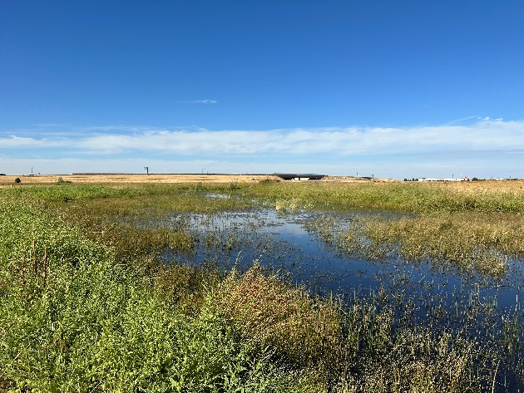
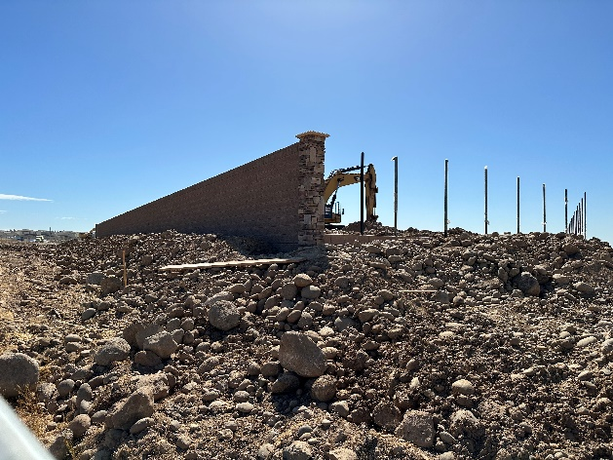
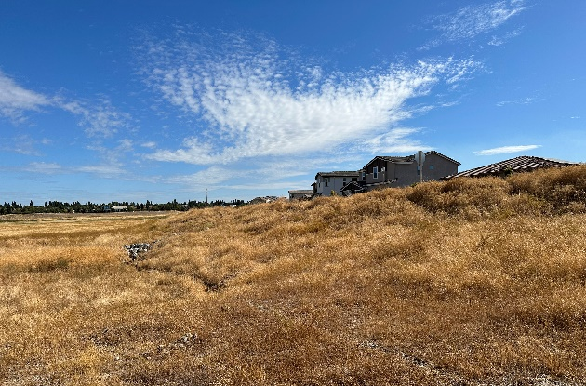
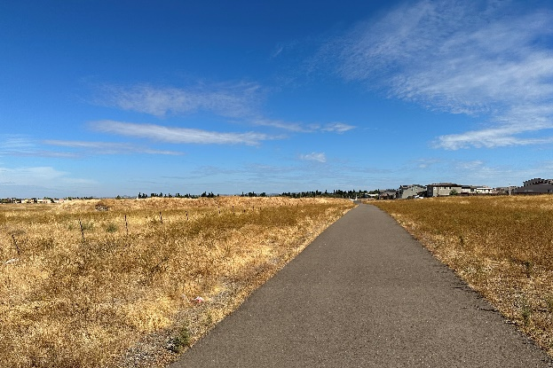
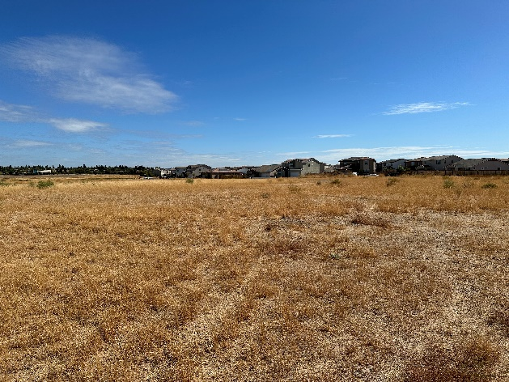
Park Site Photos
7
4
1
6
2
8
6
3
5
1
2
7
3
4
5
8

Slide 11
Opportunities and Constraints

Slide 12
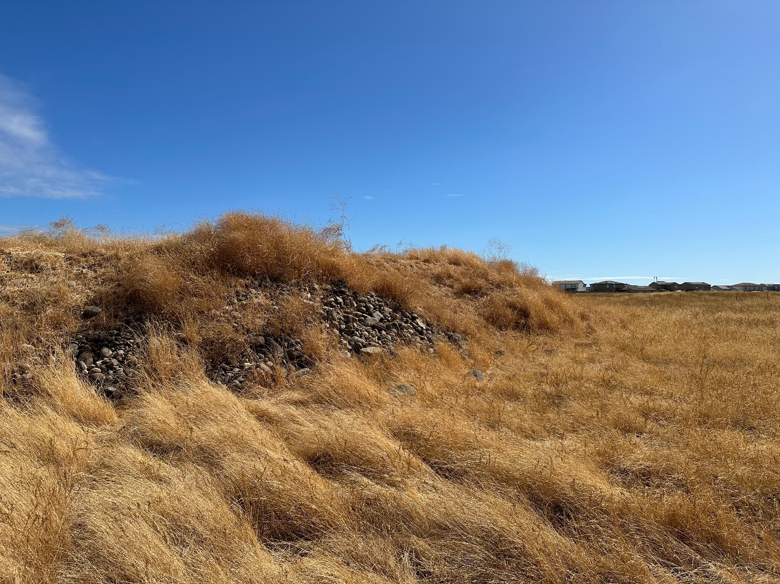

Preliminary Field Work
Site photography for design layout and context.
Biological resources on/adjacent the project site.
Cultural resources on/adjacent the project site.
Base mapping: topography, adjacent roadways/ramps, sidewalks, lighting, fences, existing utilities, stormwater features, and aerial imagery.
Subsurface conditions to provide evaluation/ recommendations for structure foundation design, pavement design, and soil fertility.

Slide 13
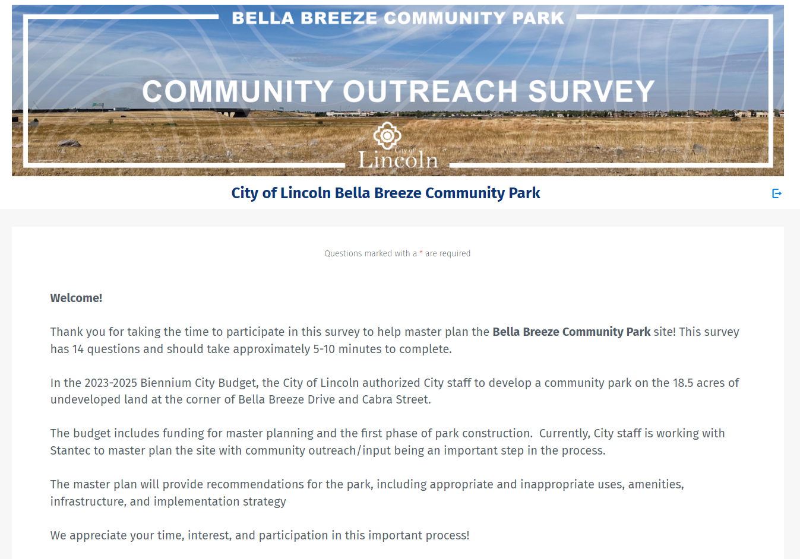

Community Survey
responses
to date!
900+
Bella Breeze Master Plan Website

Slide 14
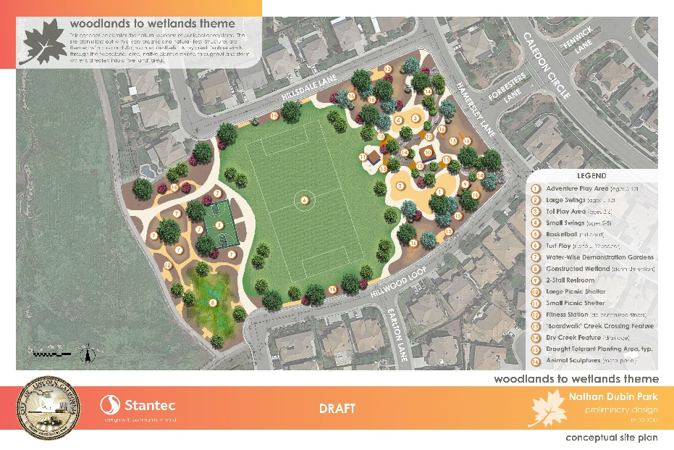
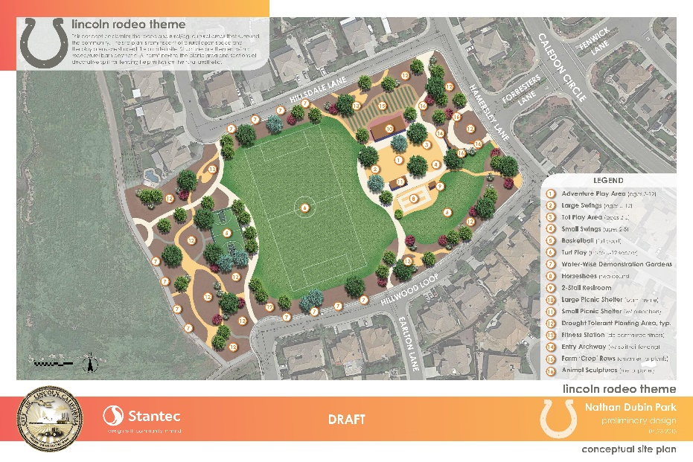
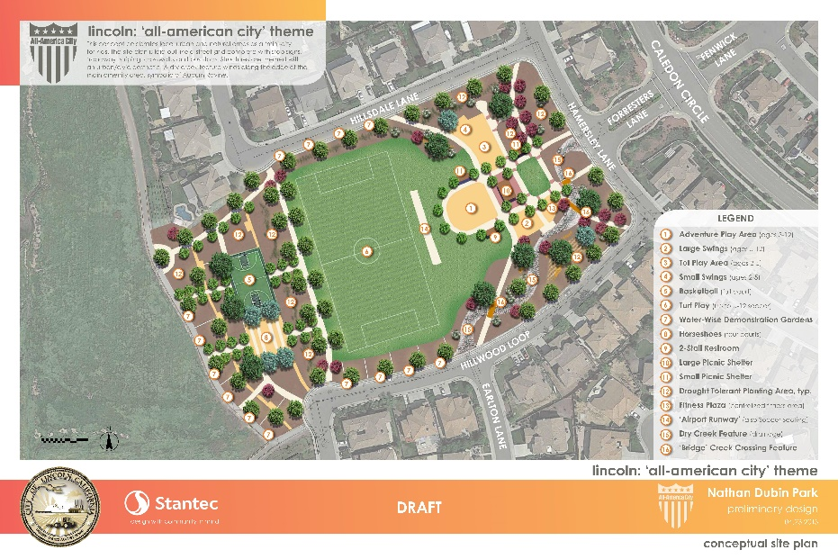
CITY OF LINCOLN | Bella breeze community park
Example Preliminary Design Concepts

Slide 15
Community Outreach Open Forum
YOUR IDEAS
  Amenities/Facilities
  Design/Theme
  Safety
  Beautification
  Priorities/Preferences
Your feedback today and in the online SURVEY will help inform the concept designs we’ll review together in December.

Slide 16
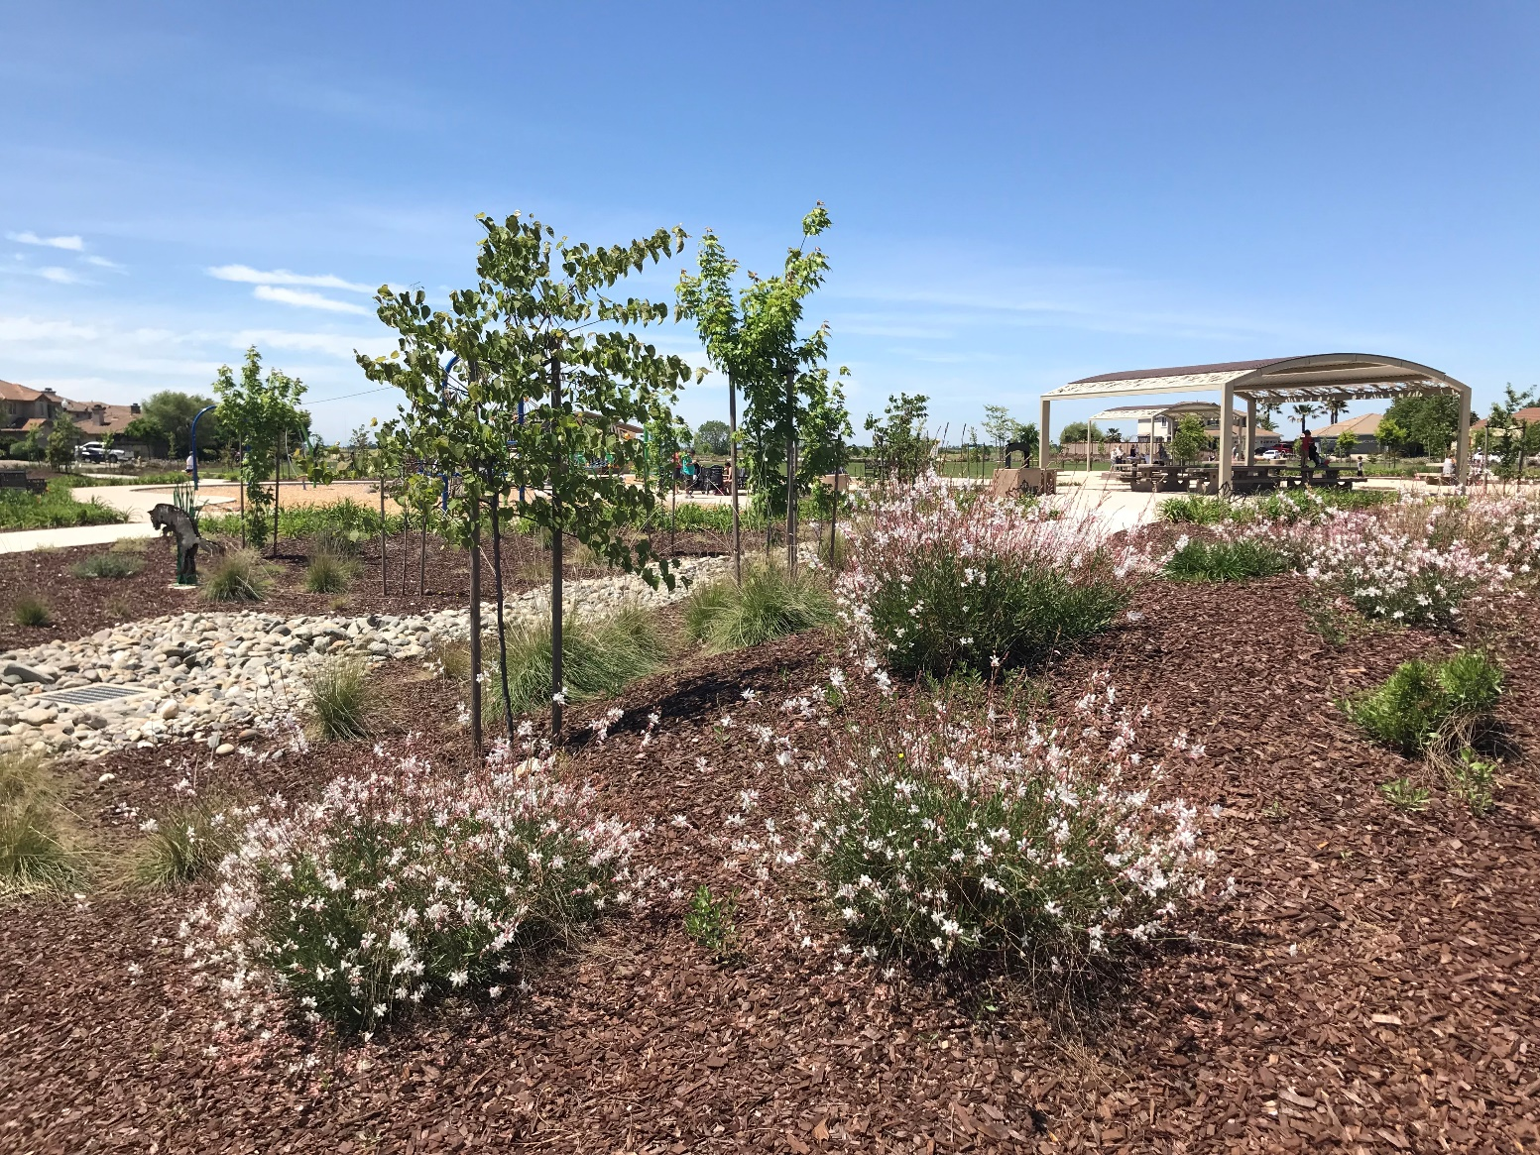
Amenities, Facilities, Design & Theme
If you have any ideas for the design of the park itself (overall) or design ideas for any of the specific facilities that you would like to see built, please share!
Maybe its an overall theme or a great example you have seen locally or in your travels.
Every idea counts!

Slide 17
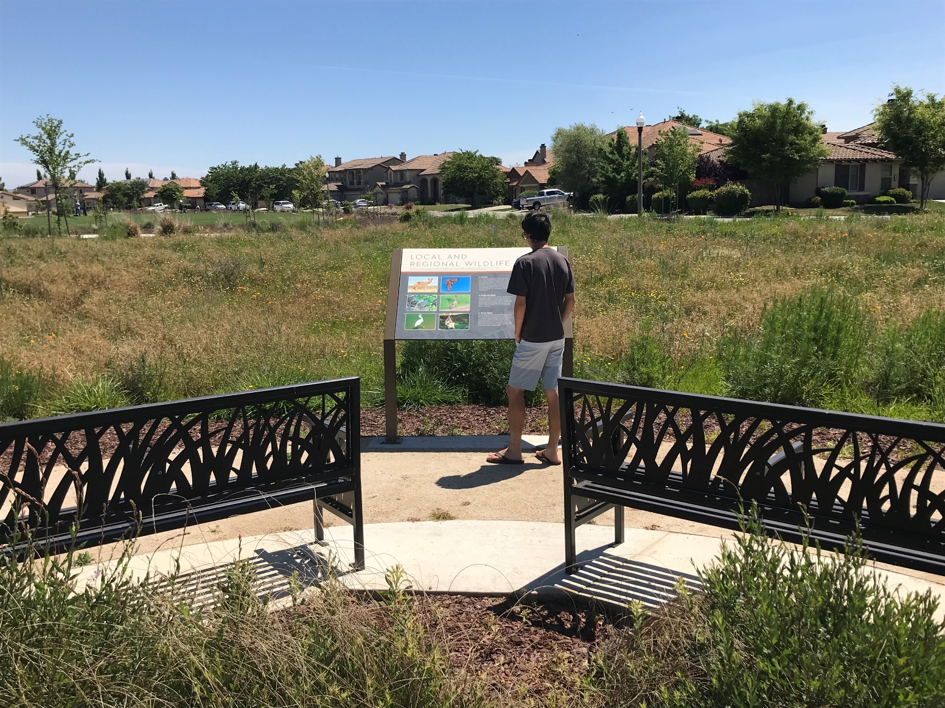
Safety Ideas
Safety is a top priority in the design of any public space.
Please tell us any ideas you may have for how we can design this park and its facilities to promote and enhance safety of its users.
Are there any examples or experiences locally or in your travels you can share?

Slide 18
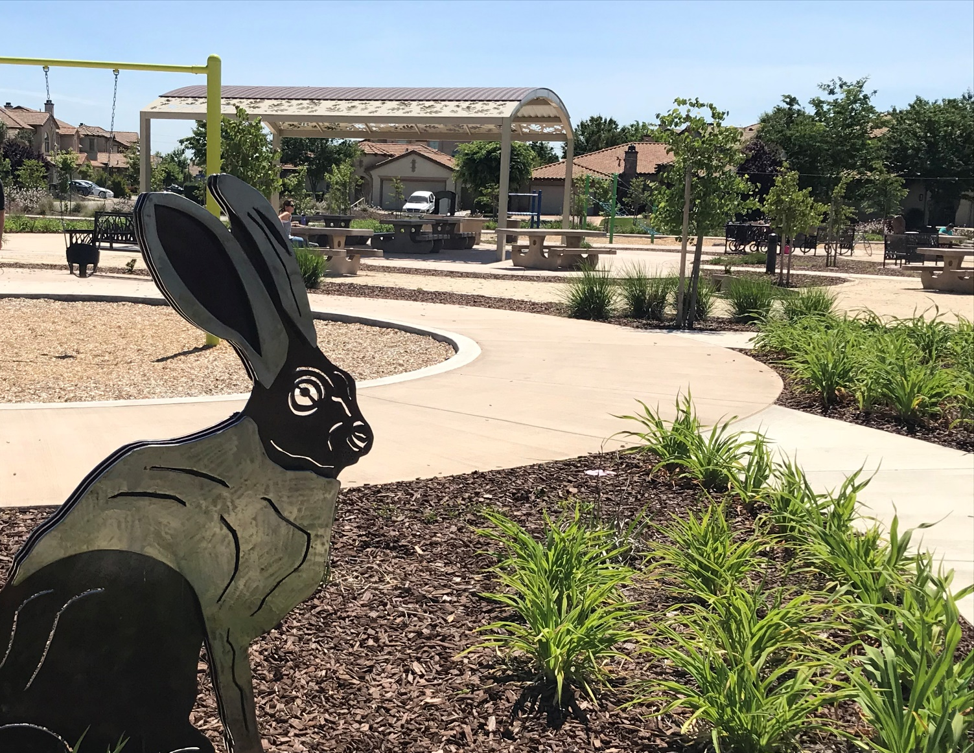
Beautification Ideas
Landscape and public art are important to the quality and feel of any public space.
In some cases, they can become the identity of the space!
Please tell us any ideas you may have for how we can design this place to become an attractive addition to the community.

Slide 19
Summary & Next Steps
October 9th – October 23rd, 2023
  Community Outreach Survey #1 – Amenity Preferences and Design Ideas. OPEN NOW!
October 17th, 2023
  Community Outreach Meeting #1 – Amenity Preferences and Design Ideas. Held virtually via ZOOM. WE ARE HERE.
December 6th, 2023
  Parks and Recreation Committee Meeting #1 – Three Preliminary Design Concepts.
December 11th, 2023
  Community Outreach Meeting #2 – Three Preliminary Design Concepts reviewed. In-person Twelve Bridges Library Willow Room.
December 11th – January 9th, 2023
  Community Survey #2 - Three Preliminary Design Concepts and Phase 1 Construction Priorities.
  March, 2024
  Preferred Master Plan for approval at Park and Recreation Committee and City Council including Phase 1 boundary.
2025 Construction currently anticipated to begin
Bella Breeze Master Plan Website

Slide 20
Thank You!
Questions?:
araceli.cazarez@lincolnca.gov
Latest Project Information and Survey:
Bella Breeze Park Master Plan - City of Lincoln (lincolnca.gov)

